Slide 1
A Visual Password Recognition Application Based On American Sign Language
Wei Dang
Kevin Ellsworth
Cory Shirts

Slide 2
Overview
Goal: have a user interface to allow user text input using sign language digits and letters
User interface
Development of the algorithm
Demonstration

Slide 3
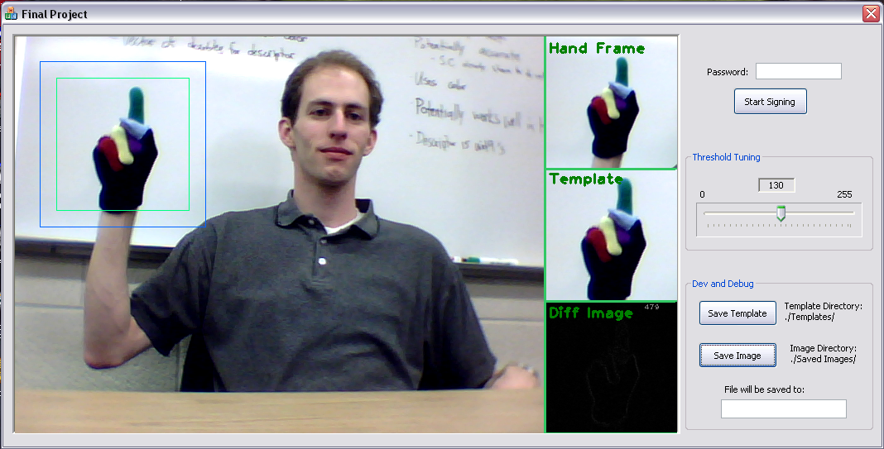
The User Interface
Include screenshot,
Notes:
Explain the screenshot and briefly describe the layout of the GUI

Slide 4
Initial Algorithm
User enters text
Wait for input sign
Thresholding on small ROI
Match templates
Get the best match

Slide 5


Problems
Similar signs not distinguishable with b/w template matching
Some min/max values just too close to tell
Digits worked alright by themselves
Most problems introduced when including letters
Zero
Letter o

Slide 6
Adjustments
Shape matching
Contour based algorithm (B&W)
No accuracy improvement over threshold template
Template matching with color markers
Takes longer to process
Not perfect, but more accurate
Template matching with saturation channels
Faster, but less accurate than full color
Histogram comparison
Not accurate, but could be useful along with other techniques

Slide 7
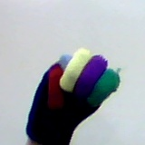
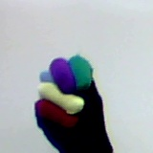
Final algorithm
Template matching on color image
Context checking for similar signs
Some signs are the same for two characters
Removed some templates for speed up
Distinct hand positions
Make difference between similar signs more distinct

Slide 8
Future Adjustments
Improve speed by matching on single channel
Saturation of HSV
Possibly other color space channel
Could try training with Haar training method
Averaging across templates or multiple methods

Slide 9
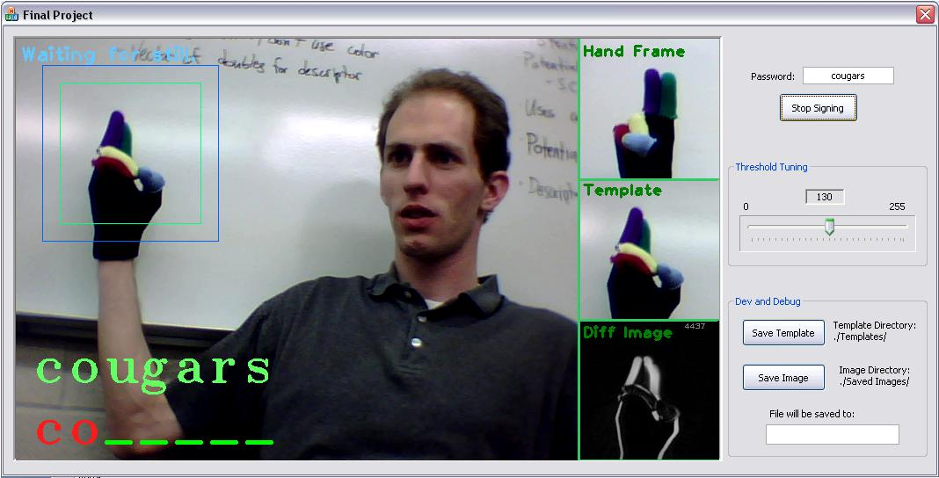
Any questions?

